Slide 1
Happy Curls
Anaija Johnson

Slide 3
Happy Curls
happycurlsbox
Happy Curls
February 12 at 11:30am
Are you just starting your natural hair journey and figuring out which products work best for your hair? Get handpicked samples of curly hair products based on your hair type delivered to your doorstep with Happy Curls. Don’t know your hair type? Take the texture quiz: bit.ly/curlyquiz
1234 W Cermak Rd, Chicago, IL 60608
www.happycurls.com
Beauty Supplier

Slide 4
Happy Curls
Post type: transformational
April 1 at 1:03 pm
Feel like you’ve tried every method in the book to get those defined curls you want? We got you, sis. We teamed up with Kinky Curly this month to provide the perfect curl defining gel, specially made for our type 4 sisters.
Post category: product awareness
The main intention behind this post is to empathize with our audience by bringing up a common issue/concern in the curly hair community and offering a solution for it through our business. This could encourage people to check out what we have to offer and potentially gain new customers.
Happy Curls
Post type: informational
June 19 at 10:50 am
Juneteenth presents an opportunity to reflect on our history and celebrate our emancipation. As we celebrate this important marker in history, we must recognize inequalities that persist and continue to fight them. 100% of this month’s subscription box proceeds will go towards #BLM!
Post category: corporate social responsibility
Happy Curls is a business that’s main customer base would most likely be black women, so it’s important to show support for causes pertaining to the black community. Knowing you’re supporting an important cause could encourage people to support your company, bringing in more customers. And if they like the subscription box they bought, they might be encouraged to buy it again in the future.

Slide 5
The objective of this ad is consideration. It’s meant to get people interested in this month’s box to increase sales.
Chicago, IL and surrounding cities; all ages
Messages because I want to reach out to those who have already interacted with our page to inform them what this month’s box features and get them interested.
$50 lifetime budget

Slide 6
The objective of this ad is awareness. This is to make our brand known to more people, thus potentially increasing our customer base.
Chicago, IL and surrounding cities; all ages
Feeds because they allow high visibility for our ad, which is essential when trying to increase reach and brand awareness.
$70 lifetime budget

Slide 7
The objective of this ad is consideration because it increases number of likes on our page.
Chicago, IL and surrounding cities; all ages
I chose feeds so that it reaches people who have never interacted with our brand and catches the attention of people who celebrate Juneteenth and would like to support the holiday.
$80 lifetime budget

Slide 8
The objective of this ad is consideration because it uses messages to encourage people to buy our subscription box.
Chicago, IL and surrounding cities; all ages
Messages because it communicates with existing customers who may have not seen our post.
$100 lifetime budget

Slide 9
1. Sign up for a Happy Curls box today and receive 25% off your purchase. First time customers only. Use code CURLEDUP
2. Looking to support a black-owned business this Black History Month? Sign up for this month’s Happy Curls box to receive samples of Alikay Naturals, an up and coming hair-care brand by the same woman who created the L.O.C. method: Rochelle Graham-Campbell.

Slide 10
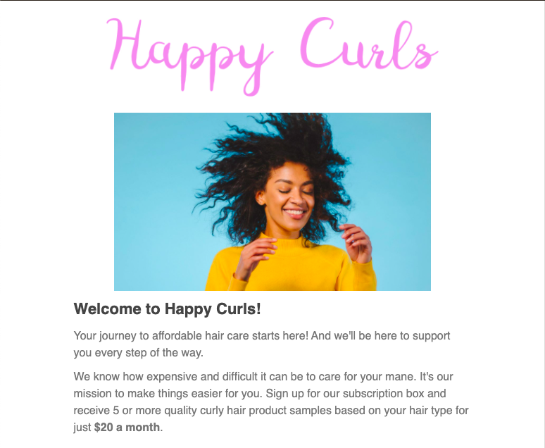
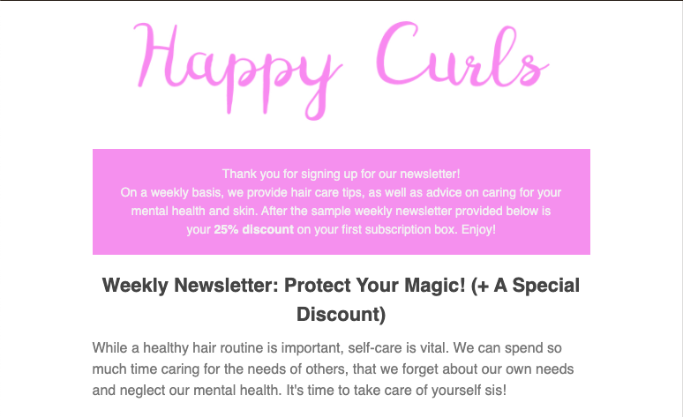
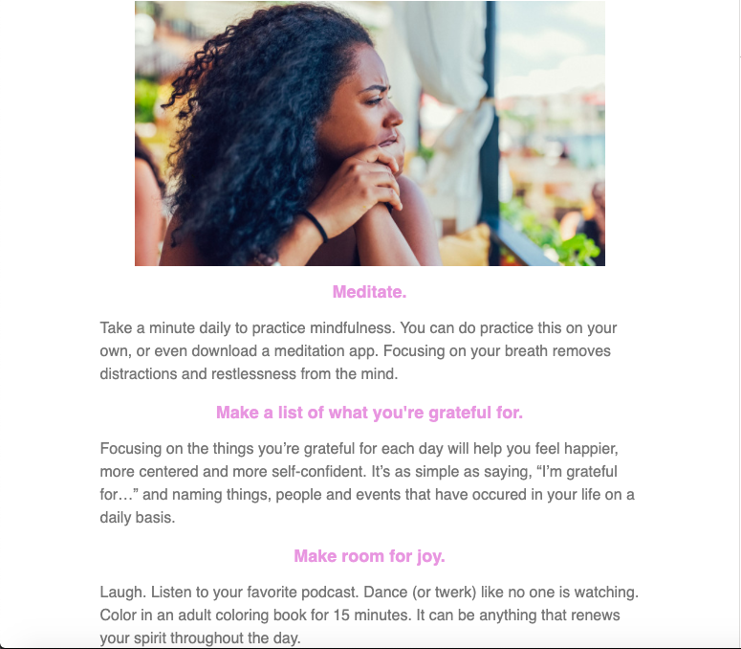
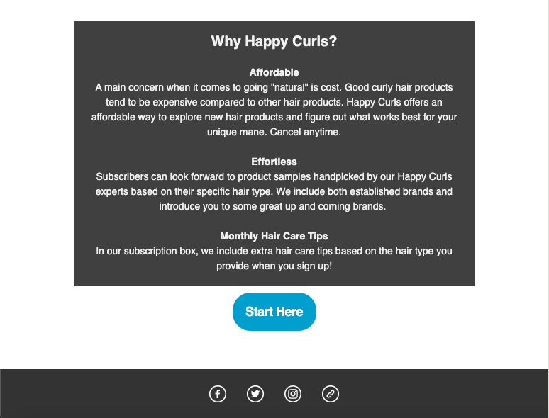
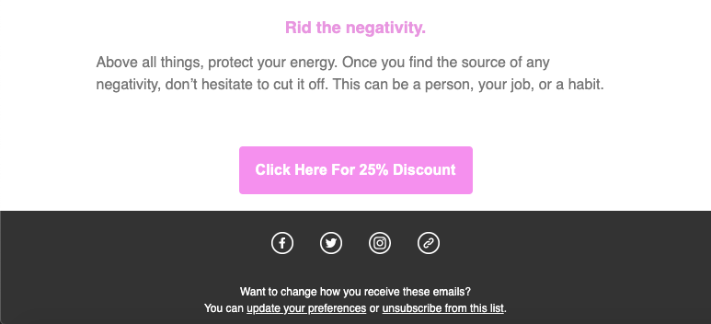
Welcome Email
Newsletter

Slide 11
